Slide 1
08 Dimensionality Reduction

Slide 2
What is dimensionality reduction?
Dimensionality reduction (or dimension reduction) is the process of reducing the number of random variables by obtaining a set of principal variables.
차원축소 : 주요 변수 집합을 얻어서 확률변수의 수를 줄이는 과정
It is the process of reducing the number of features and obtaining a smaller number of features.
피쳐의 수를 줄임

Slide 3
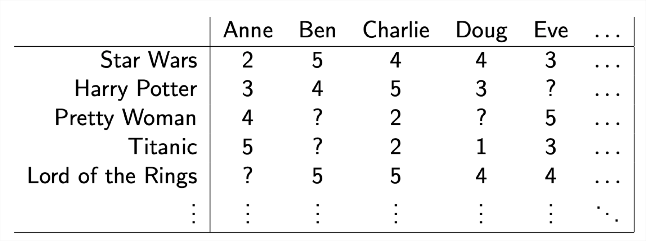
High-dimensional Data
Netflix movie rating data
Rows: movies
Columns: customers
Cells: ratings (scale of 1-5)
In the third quarter of 2018, Netflix had over 137 million streaming subscribers worldwide. Of these subscribers, 58.46 million were from the United States.
https://www.statista.com/statistics/250934/quarterly-number-of-netflix-streaming-subscribers-worldwide/

Slide 4
High-dimensional Data
Biomedical data
Image data
Network data
Text data
And more …

Slide 5
Why dimensionality reduction?
A large number of features make training slow.
Many machine learning problems involve thousands or even millions of features.
Reducing dimensionality may filter out noise and unnecessary details.
Some features may overlap and correlated.
Dimensionality reduction is useful for data visualization.
Reducing the number of dimensions down to two (or three) makes it possible to plot high-dimensional data and visually detect patterns.
1. 더 나은 성능의 모델을 만들기 위해
2. 이해하기 쉬운 모델을 만들기 위해
3. 더 빠르게 실행되는 모델을 만들기 위해

Slide 6
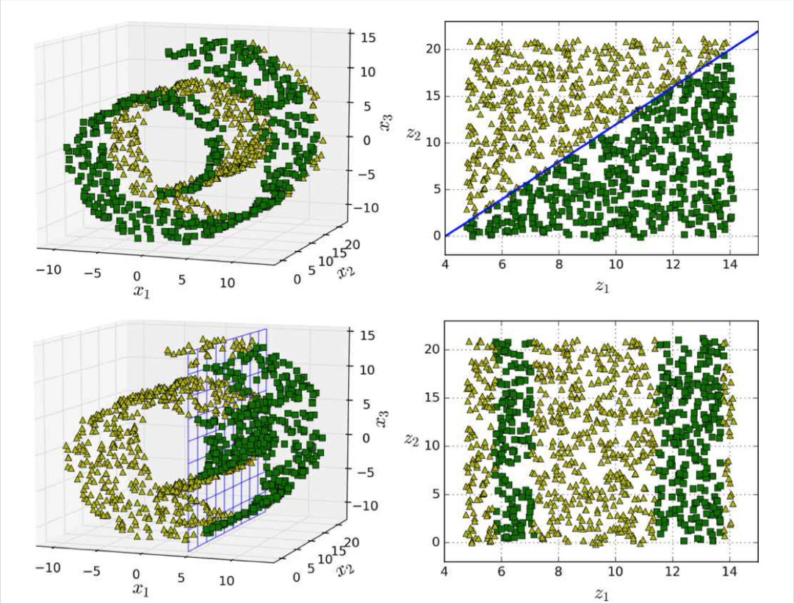
Dimensionality Reduction
Dimensionality reduction does not always result in a better solution.
반드시 차원축소가 좋은 것은 아니다.
Reducing dimensionality loses some information, it might be noise or might be some useful information. 정보손실(노이즈? 중요한 정보?)
It may make your machine learning model perform worse. 성능저하 가능성
Dimensionality reduction does not always result in a simple solution.
항상 간단한 솔루션이 되는 것도 아니다.
Decision boundary become simpler (간단해짐 - 성공)
From a complex hyperplane in 3D space to a straight line in 2D space
Decision boundary become more complex (복잡해짐)
Form a vertical plane in 3D space to four line segments in 2D space

Slide 7
Dimensionality Reduction
Dimensionality reduction definitely speed up training, but it may not always lead to a better or simpler solution, it all depends on the dataset.
확실한건 속도가 빨라진다. (데이터가 줄어드니까)
그러나 더 좋거나 간단한 솔루션이라는 보장은 없다.
Rule of thumb
First try to train your ML model with the original features unless you clearly know some features are redundant.
일단 원래 피쳐로 수행을 한다
Perform dimensionality reduction as a second step.
그리고나서 차원 축소로 진행한다.

Slide 8
Types of dimensionality reduction
Feature selection
Selects a subset of the original features.
기존의 피쳐에서 고르는 것
Feature extraction
Derives information from the feature set to construct a new feature subspace.
기존의 피쳐를 기반으로 새로운 정보를 추출하는 것

Slide 9
Feature Selection vs. Feature Extraction
Feature selection
A subset of the original features are selected.
The selected features are not transformed.
하위 집합은 변하지 않는다.
Feature extraction
All original features are used after transformation.
The transformed features are linear combinations of the original features.
변환된 피쳐는 원래의 피쳐의 선형조합이다.

Slide 10
Feature Selection
Motivation
To automatically select a subset of features that are most relevant to the problem and remove irrelevant features or noise.
가장 관련 없는 것을 제거한다.
To improve computational efficiency and reduce generalization error.
계산 효율성 높이고, 일반화 오류를 줄인다.
Approach
Is a combination of a search technique for proposing new feature subsets, along with an evaluation measure which scores the different feature subsets.
새로운 하위 집합을 만드는 검색기술, 다른 피쳐 서브셋의 점수를 측정하여서
The simplest algorithm is to test each possible subset of features finding the one which minimizes the error rate.
가장 간단한 알고리즘 : 오류율을 최소화 하는 피쳐들의 서브셋을 찾는다.
https://scikit-learn.org/stable/modules/feature_selection.html

Slide 11
Feature Selection
Filtering Method
Filtering은 사전적 의미 처럼 도움이 되지 않는 피처들을 걸러내는 작업을 말합니다. 통계적인 측정 방법을 이용하여 피처들의 상관관계를 알아내고 적합한 피처들만 선택하여 알고리즘에 적용하는 방식입니다.
ex) t-test /chi-square test /Information Gain
Wrapper Method
wrapper는 예측 모델을 사용하여 피처들의 부분 집합을 만들어 계속 테스트 하여 최적화된 피처들의 집합 만드는 방법 입니다. 최적화된 모델을 만들기 위해 여러번 모델을 생성하고 성능을 테스트 해야 하기 때문에 많은 시간이 필요합니다. 충분한 시간이 있다고 하면 wrapper 방법을 사용해도 좋지만 시간이 없다면 다른 방법을 사용하는 것을 추천합니다.
ex) Forward Greedy/Backward Greedy/Genetic Search/Local Search
Embedded Method
Embedded는 Filtering과 Wrapper의 장점을 결합한 방법으로 학습 알고리즘 자체에 feature selection을 넣는 방식입니다.
ex) LASSO = L1 regularisation / RIDGE = L2 regularisation
https://scikit-learn.org/stable/modules/feature_selection.html

Slide 12
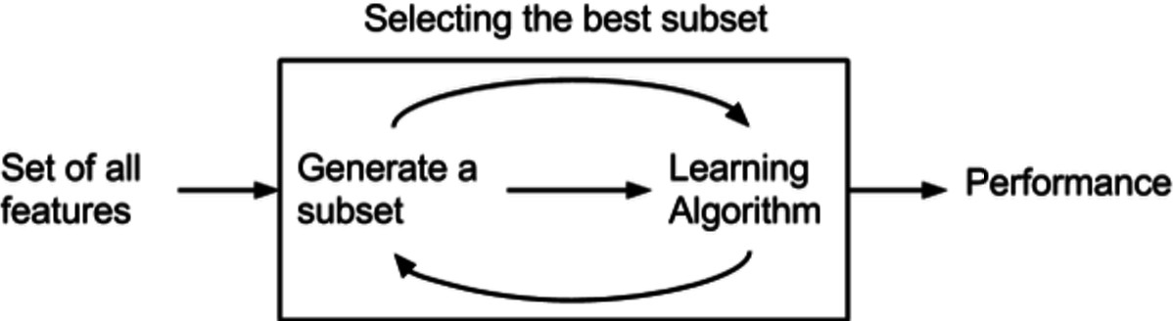
Feature Selection Methods
Wrapper methods
Use a predictive model to score feature subsets. Each new subset is used to train a model, which is tested on a hold-out set.
예측 모델을 사용하여, 피쳐 서브셋에 점수를 매긴다. 각 새로운 집합은 모델을 학습하고, 홀드아웃셋으로 다시 테스트 된다.
The error rate of the model gives the score for a subset.
각 서브셋의 에러율이 점수가 된다.
As wrapper methods train a new model for each subset, they are very computationally intensive, but usually provide the best performing feature set for that particular type of model.
각 하위 집합에 대해 매번 새로운 모델을 학습하기에 계산이 많지만 보통 특정 모델에 대한 가장 좋은 서브셋을 찾아준다.

Slide 13
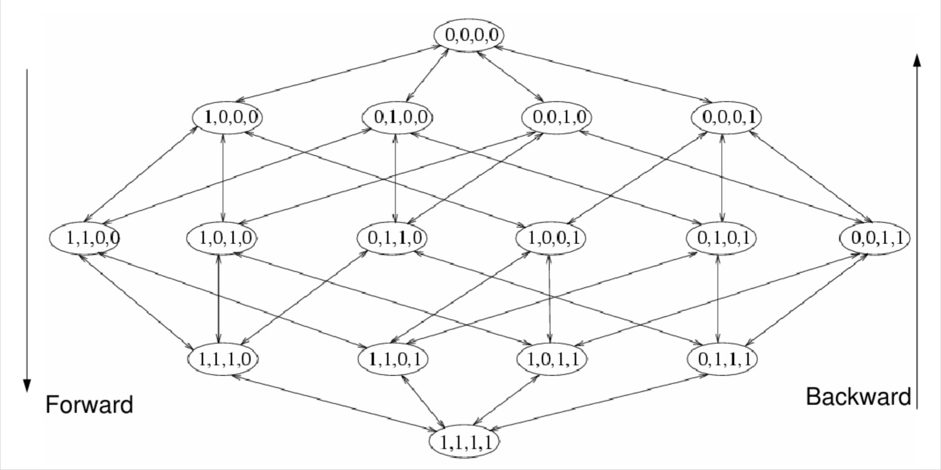
Wrapper Methods
Subset search
Search taring point: empty set vs. full set
Search direction: sequential forward selection vs. sequential backward elimination
Search strategies: exhaustive/complete vs. random

Slide 14

Feature Selection Methods
Filter methods
Use a proxy measure instead of the error rate to score a feature subset.
오류율 대신 근접성을 측정한다.
E.g., Mutual information, correlation coefficient, significant tests
Less computationally intensive than wrappers, but they produce a feature set which is not tuned to a specific type of predictive model.
Wrapper 보다는 계산이 덜 들어가지만, 특정 모델에 적합한 피쳐를 뽑지는 않음
This lack of tuning means a feature set from a filter is more general than the set from a wrapper.
조정이 부족하다는 것은 해당 피쳐셋이 모델과 상관없이 더 일반적이라고 볼 수 있음

Slide 15
Filter Methods
Removing features with low variance 분산이 낮은 피쳐들 제거
Unsupervised (uses only the features, not the target)
Low variance features do not good at differentiation.
서로 샘플간의 차이가 되지 못한다.
>>> | X = [[0, | 2, | 0, | 3],
 | [0, | 1, | 4, | 3],
 | [0, | 1, | 1, | 3]]
>>> selector = VarianceThreshold()
>>> selector.fit_transform(X)
array([[2, | 0],
[1, | 4],
[1, | 1]])

Slide 16
Filter Methods
Univariate feature selection (단변량 특성 선택)
Selects the best features based on univariate statistical tests
X² test
Measures dependence between variables. 변수간의 종속성 측정
Compute chi-squared stats between each feature and class.
Select features with the highest values and “weeds out” features that are independent of class. 가장 높은 피쳐 선택, 클래스와 상관 없는 피쳐 제거
>>> from sklearn.datasets import load_iris
>>> from sklearn.feature_selection import SelectKBest
>>> from sklearn.feature_selection import chi2
>>> iris = load_iris()
>>> X, y = iris.data, iris.target
>>> X.shape
(150, 4)
>>> X_new = SelectKBest(chi2, k=2).fit_transform(X, y)
>>> X_new.shape
(150, 2)

Slide 17
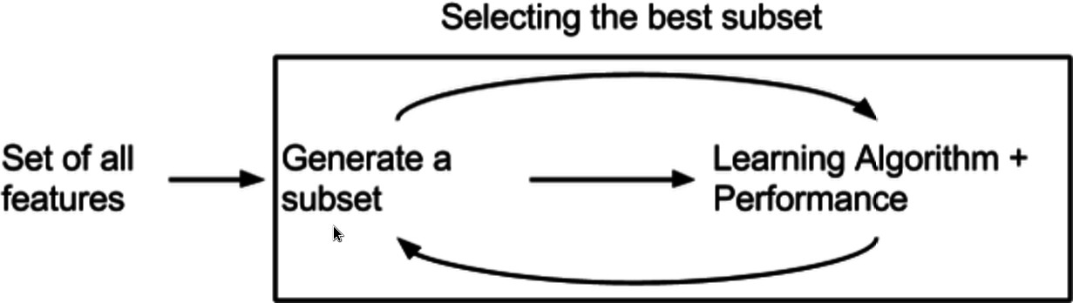
Feature Selection Methods
Embedded methods
Perform feature selection as part of the model construction process.
모델 구성의 일부로 수행함
Feature selection is embedded in and specific to a model.
LASSO (linear regression with L1 regularization)
Penalizes the regression coefficients with an L1 penalty.
L1 패널티로 회귀계수에 패널티 적용
Any features which have non-zero regression coefficients are 'selected' by the LASSO algorithm.
회귀 계수가 0이 아닌 피쳐는 모두 선택된다.

Slide 18
Embedded Methods
L1-based
Use linear models penalized with the L1 norm.
Select features with coefficients not zero.
Regression: Lasso
Classification: Logistic Regression, LinearSVC
Estimators have the coef_ attribute.
>>> from sklearn.svm import LinearSVC
>>> from sklearn.datasets import load_iris
>>> from sklearn.feature_selection import SelectFromModel
>>> iris = load_iris()
>>> X, y = iris.data, iris.target
>>> X.shape
(150, 4)
>>> lsvc = LinearSVC(C=0.01, penalty="l1", dual=False).fit(X, y)
>>> model = SelectFromModel(lsvc, prefit=True)
>>> X_new = model.transform(X)
>>> X_new.shape
(150, 3)

Slide 19
Embedded Methods
Tree-based
Tree-based estimators can be used to compute feature importance.
Estimators have feature_importance_ attribute.
>>> from sklearn.ensemble import ExtraTreesClassifier
>>> from sklearn.datasets import load_iris
>>> from sklearn.feature_selection import SelectFromModel
>>> iris = load_iris()
>>> X, y = iris.data, iris.target
>>> X.shape (150, 4)
>>> clf = ExtraTreesClassifier(n_estimators=50)
>>> clf = clf.fit(X, y)
>>> clf.feature_importances_
array([ 0.04..., 0.05..., 0.4..., 0.4...])
>>> model = SelectFromModel(clf, prefit=True)
>>> X_new = model.transform(X)
>>> X_new.shape (150, 2)

Slide 20
Feature extraction
Transforms the original dataset onto a new feature subspace of lower dimensionality than the original one.
차원이 낮은 새로운 공간으로 변환
Is an approach to data compression with the goal of maintaining most of the relevant information.
데이터 정보 유지를 위한 압축방식
Techniques
Projection-based
Manifold Learning

Slide 21
Principal Component Analysis (PCA)
The most popular dimensionality reduction algorithm.
An unsupervised linear transformation technique.
PCA identifies the hyperplane that preserves the maximum amount of variance, and then it projects the data onto it.
최대 분산량을 유지하는 초평면을 찾아서, 거기에 투영
Variance
Variance is the expectation of the squared deviation of a random variable from its mean.
확률변수의 제곱 편차에 대한 기댓값
It measures how far a set of numbers are spread out from their average value.
평균값에서 얼마나 멀리 퍼져 있는지 측정

Slide 22
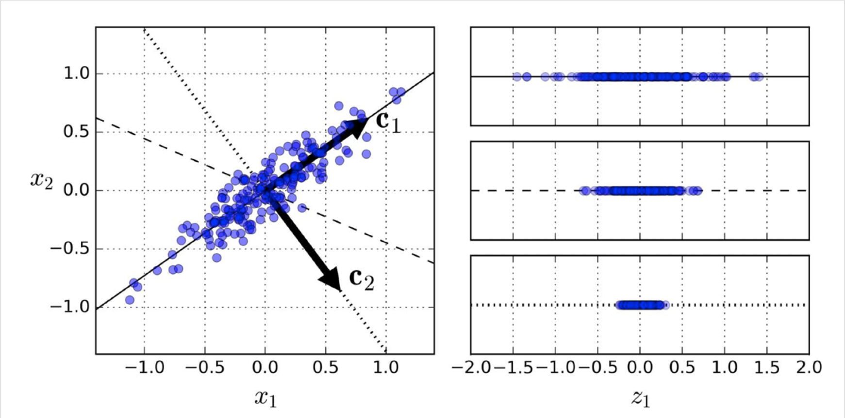
Principal Component Analysis (PCA)
Which one is the right hyperplane?
A 2D dataset & three axes (one-dimensional hyperplanes)
The projection onto the solid line preserves the maximum variance. 최대분산
The projection on to the dotted line preservers very little variance. 편차가 거의 없음
Selects the axis that preserves the maximum amount of variance, as it will
lose less information than the other projections.
최대 분산량을 유지하는 축을 선택해서 다른 예측보다 정보 손실이 적다.
Projection

Slide 23
Principal Component Analysis (PCA)
After finding the first axis,
Finds a second axis, orthogonal to the first one, that accounts for the largest amount of remaining variance.
첫번쨰 축과 직교하는 두 번째 축을 찾는다. (남아있는 분산의 가장 큰 양을 설명
Finds a third axis, orthogonal to both previous axes,
Finds a fourth, a fifth, and so on — as many axes as the number of dimensions in the dataset.
Why orthogonal?
In order to preserve the maximum amount of variance even after finding the first axis, we need to find a second one that is totally uncorrelated to the first one.
첫번쨰 축과 가장 관련이 없어야 하므로 직교하는 것을 찾음
If two variables are uncorrelated they are orthogonal and if two variables are orthogonal, they are uncorrelated.

Slide 24
Principal Component Analysis (PCA)
Principal Components
The unit vector that defines the i^{th} axis is called the i^{th} principal component.
A unit vector is a vector of length 1.
i번째 축을 정의하는 단위 벡터를 i번째 주성분이라고 합니다.
단위 벡터는 길이가 1인 벡터입니다.

Slide 25
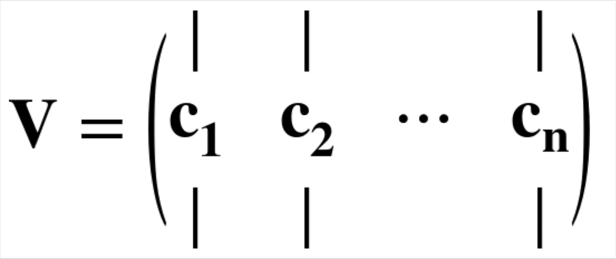
Principal Component Analysis (PCA)
Finding principal components
Singular Value Decomposition (SVD)
Decomposes a training set matrix X into the dot product of three matrices: X =U · Σ · V^{T}, where X is a 𝑚×𝑛 matrix, U is a 𝑚×𝑚 unitary matrix, Σ is 𝑚×𝑛 rectangular diagonal matrix, and V is n×𝑛 unitary matrix.
X =U · Σ · V^{T}, X를 세 개의 행렬의 곱으로 표기할 수 있다.
V contains all the principal components.
V는 모든 주성분을 포함한다.

Slide 26
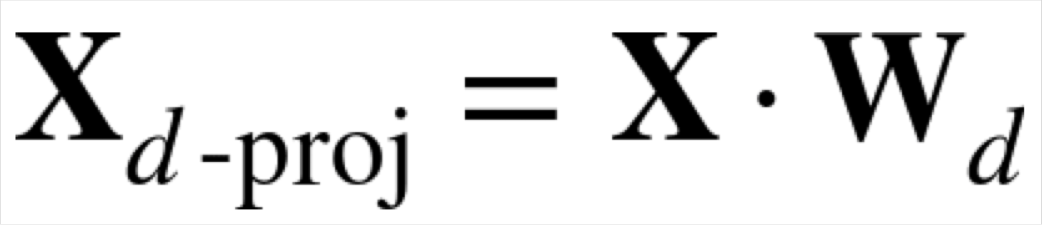
Principal Component Analysis (PCA)
Projecting down to d dimensions
After finding all the principal components, project the dataset onto the hyperplane defined by the first d components.
모든 주성분을 찾은뒤, 첫번째 d 컴포넌트로 정의된 초평면에 데이터를 투영
Compute the dot product of the training set matrix X by the matrix W_{d}, defined as the matrix containing the first d principal components (the matrix composed of the first d columns of V)
훈련셋 행렬 x의 내적을 행렬 Wd로 계산.
행렬은 처음 d개의 주성분을 포함하는 행렬로 정의됩니다.

Slide 27
Principal Component Analysis (PCA)
Choosing the right number of dimensions
Choose the number of dimensions that add up to a certain portion of the variance (e.g., 95%).
분산의 특정 부분을 합산하는 차원수를 선택
Explained variance ratio 설명되는 분산 비율
It indicates the proportion of the dataset’s variance that lies along the axis of each principal component.
각 주성분의 축을 따라 잇는 데이터셋의 분산 비율을 나타냄
E.g., 1st component (80%), 2nd component(15%), 3rd component (3%), etc.

Slide 28
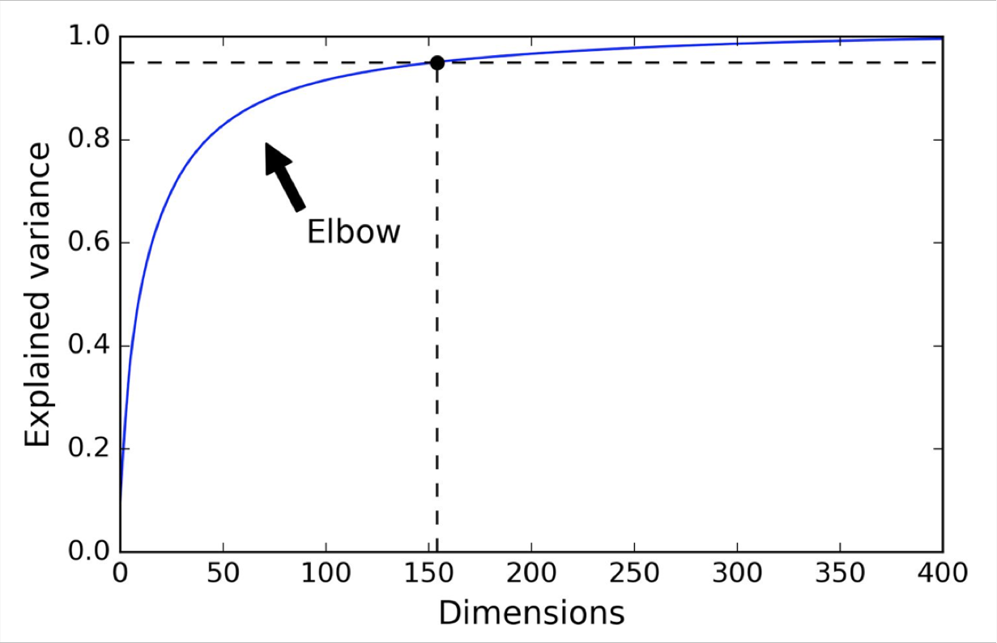
Principal Component Analysis (PCA)
Choosing the right number of dimensions
Plot the explained variance as a function of the number of dimensions.
Elbow:The point where the explained variance stops growing fast.

Slide 29
Linear Discriminant Analysis (LDA)
PCA versus LDA
PCA attempts to find the orthogonal component axes that maximize variance in a dataset whereas LDA attempts to find the feature subspace that optimizes class separability.
PCA 는 데이터셋의 분산을 최대화 하는 직교 구성 요소 축을 찾으려고함.
LDA 는 클래스 분리성을 최적화 하는 피쳐서브셋을 찾으려고 함
PCA is an unsupervised whereas LDA is a supervised dimensionality reduction algorithm. LDA takes class label information into account.
PCA는 unsupervised,
LDA 는 supervised : LDA 는 클래스 라벨을 고려함

Slide 30
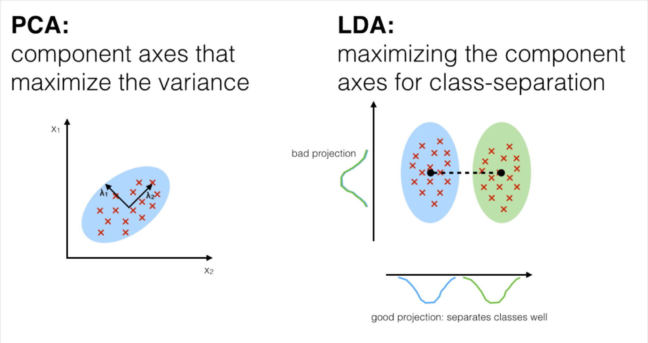
Linear Discriminant Analysis (LDA)
The goal of LDA is to
Project a feature space onto a smaller subspace while maintaining the class- discriminatory information.
클래스 차이 정보를 유지하면서~ 피쳐 스페이스를 더 작게 만드는 것
Find the directions (linear discriminants) that represent axes that maximize the separation between classes.
클래스 간의 분리를 최대화 하는 축을 나타내는 방향(선형판별식)을 찾습니다

Slide 31
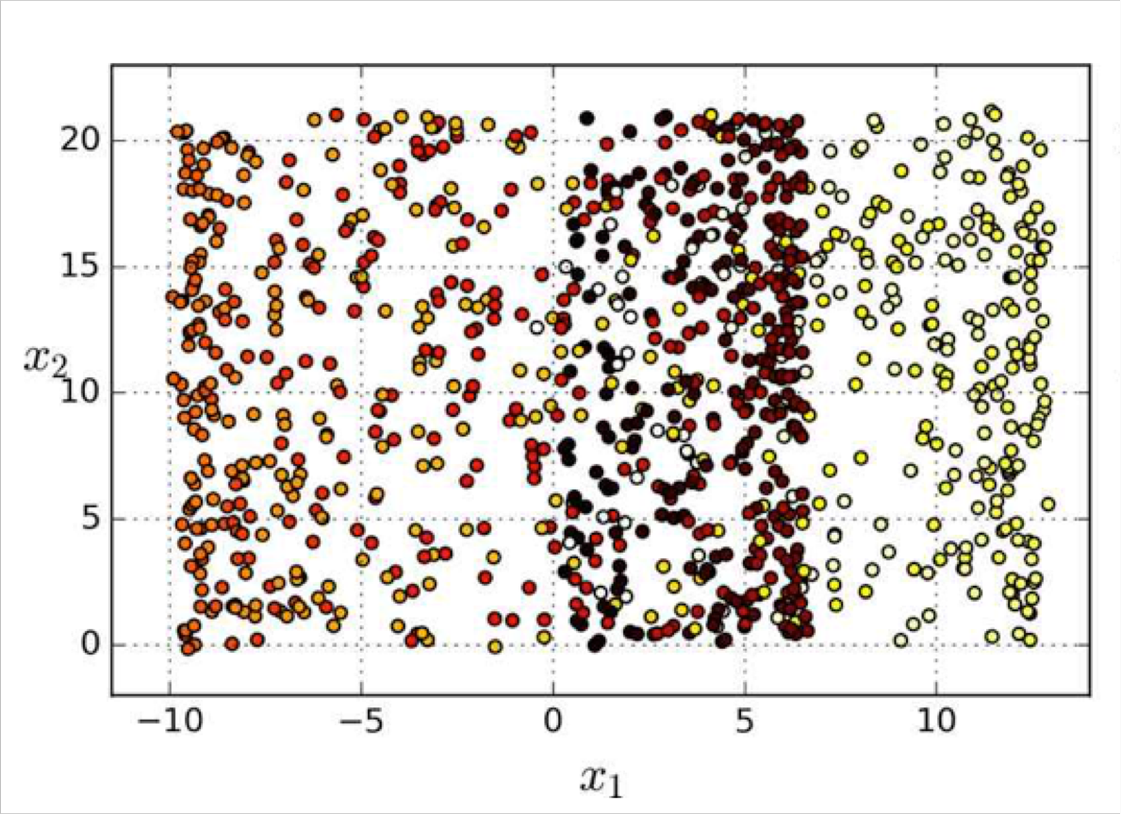
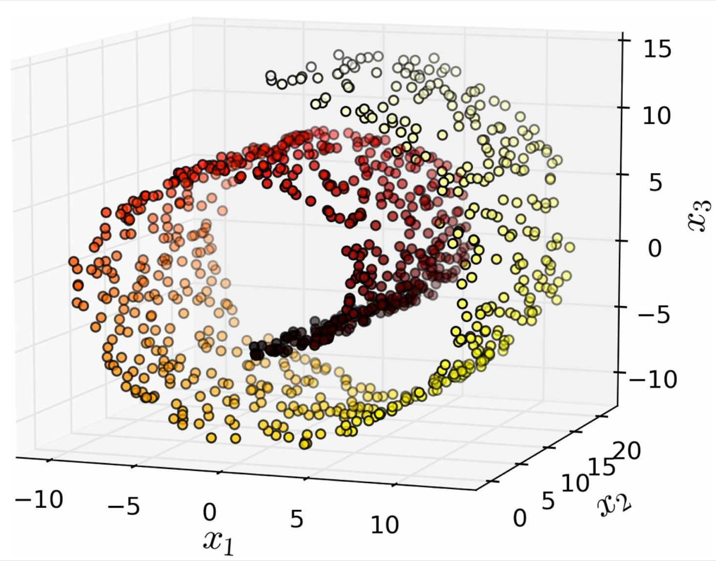
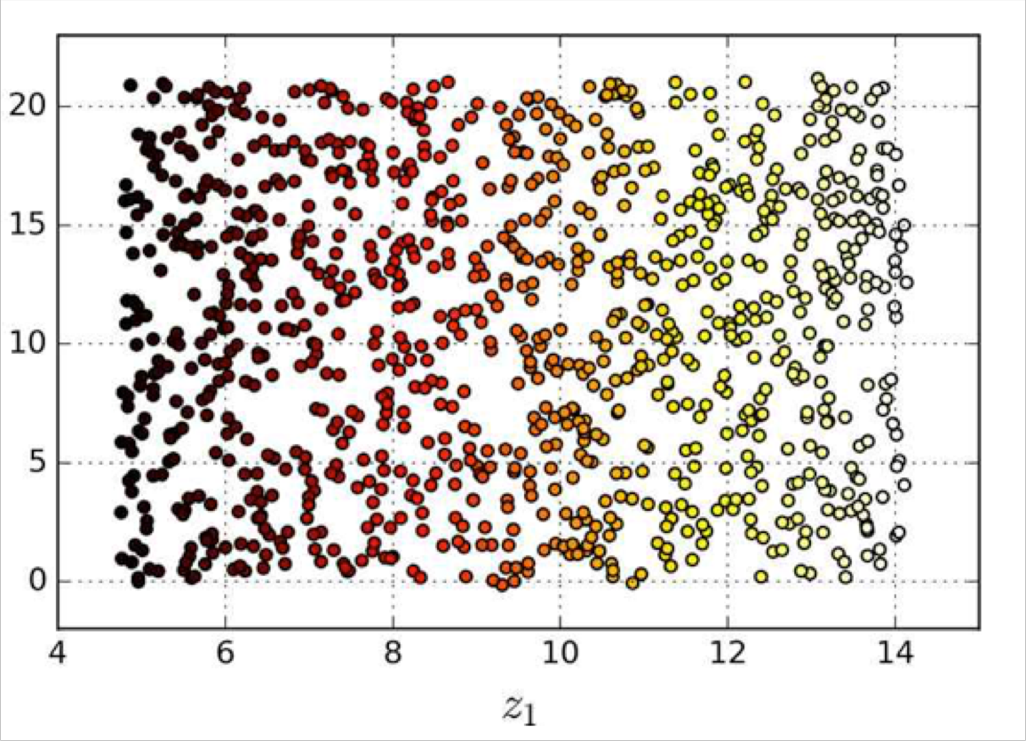
Projection & Manifold Learning
Swiss roll dataset
Projection
Unrolling

